Slide 1
Lightening Talk #2:
Project Plan
EE / CprE / SE 491 – sddec20-proj01
Machine learning for pilot biometrics
Team Members:
Jianhang Liu, Feng Lin, Xuewen Jiang, Xiuyuan Guo, Sicheng Zeng, Junjie Chen

Slide 2

Introduction
Make improvement of the given algorithm to improve prediction of the health issue of the pilot and Our intended users for the end product will be the pilot and help them protect their life from unexpected health problems which may make the warcraft out of control. However, we are the middle part of the whole large project so the constraints we have to work with are related to latency, accuracy, and memory consumption.

Slide 3
Required Components
Xilinx Suite ---- core development IDE
Ultra96v2 ---- hardware
Tensorboard ---- finding optimized hyperparameter
MIPI adapter --- integrate camera onto the ultra96v2
Camera ---- used to feed videos in to the ultra96v2
Matlab —— data manipulation software
Junjie Chen

Slide 4
Project’s key technical goals
Our goal is to improve the existing machine learning algorithm in terms of accuracy and efficiency by accelerating the algorithm from both software and hardware perspective.
Use live-feed camera input
Use Tensorflow & Keras pre-trained model on large dataset
6 x faster processing than existing algorithm
99% above accuracy on open-closed eye detection
Run open-closed eye algorithm in Ultra 96
Sicheng Zeng

Slide 5
Statement of Work
1.Using Simulink to manipulate images captured by camera before input to algorithm.
2. Improve the algorithm using hyper parameter
3. Train the neural network
4. Inference the algorithm on Ultra96 board.
5. Check whether the requirements are met.

Slide 6
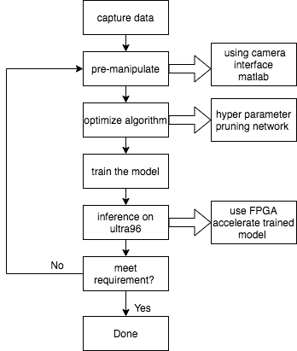
System Block Diagram
This diagram is our workflow.
We capture data from camera and pre-manipulated data using camera or matlab.
Then we want to optimize ML algorithm by using different technique.
Finally we want to use FPGA to accelerate inference speed of our train model.

Slide 7
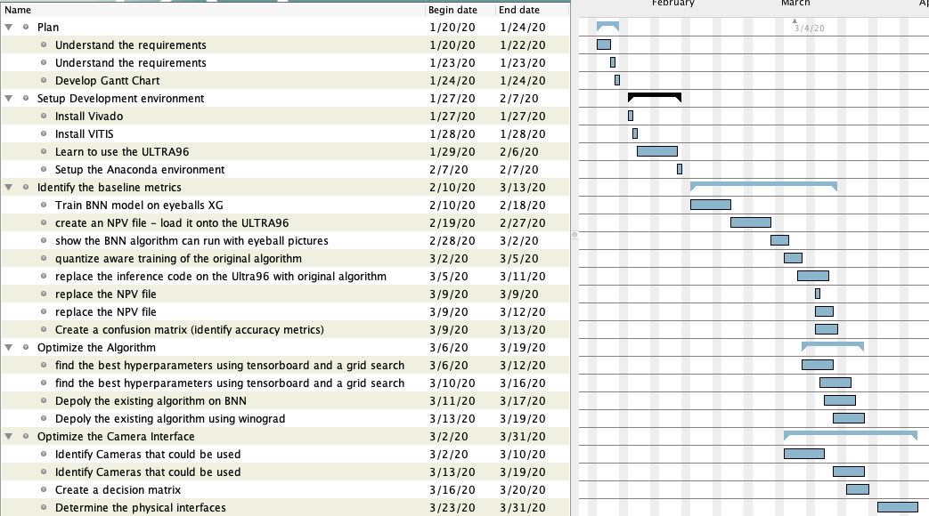
Timeline
The Gantt chart shows our
current Timeline
Plan and setup development environment are the group task.
Identify the baseline metrics, Optimize the Algorithm and Optimize the Camera interface are the individual tasks for group members and we are working now.
More tasks will be added in the future.

